Slide 1
Kubernetes Deployment Strategies and Autoscaling
Karthikeyan Vaiyapuri

Slide 2
Session Overview
Advanced Deployment Strategies
Rolling Updates and Rollbacks
Horizontal and Vertical Pod Autoscaling
Lab: Configuring HPA and VPA
Blue/Green Deployments,
Canary Deployments,
Comparison and Use Cases
Rolling Deployment Strategies
Rollback Mechanisms
HPA Configuration and Metrics
VPA Implementation
Hands-on exercises with autoscaling

Slide 3
01
Why do we need Deployment Strategies?

Slide 4
Benefits
Risk Mitigation
Minimize impact of faulty deployments
Quick Recovery
Rapidly revert to previous versions if issues arise
Key Benefits
Zero Downtime
Maintain service availability during updates
Compliance
Meet SLA requirements for high- availability services
Performance Validation
Test new versions under real traffic

Slide 5
02
Blue/Green Deployment

Slide 6
Concept
01
Two Identical Production Environments (Blue and Green)

Slide 7

Process
Step-by-Step Process
Current version runs in Blue environment
01
Deploy new version to Green environment
02
Test Green environment thoroughly
03
Switch traffic from Blue to Green instantly
04
Keep Blue as fallback until confident
05

Slide 8
Advantages
Benefits of Blue/Green Deployment
Zero downtime deployments
Simple traffic switching
Instant rollback capability
Full testing in production- like environment

Slide 9

Disadvantages
Challenges with Blue/Green Deployment
Resource intensive (requires 2x infrastructure)
Database migration challenges
Complex state management

Slide 10
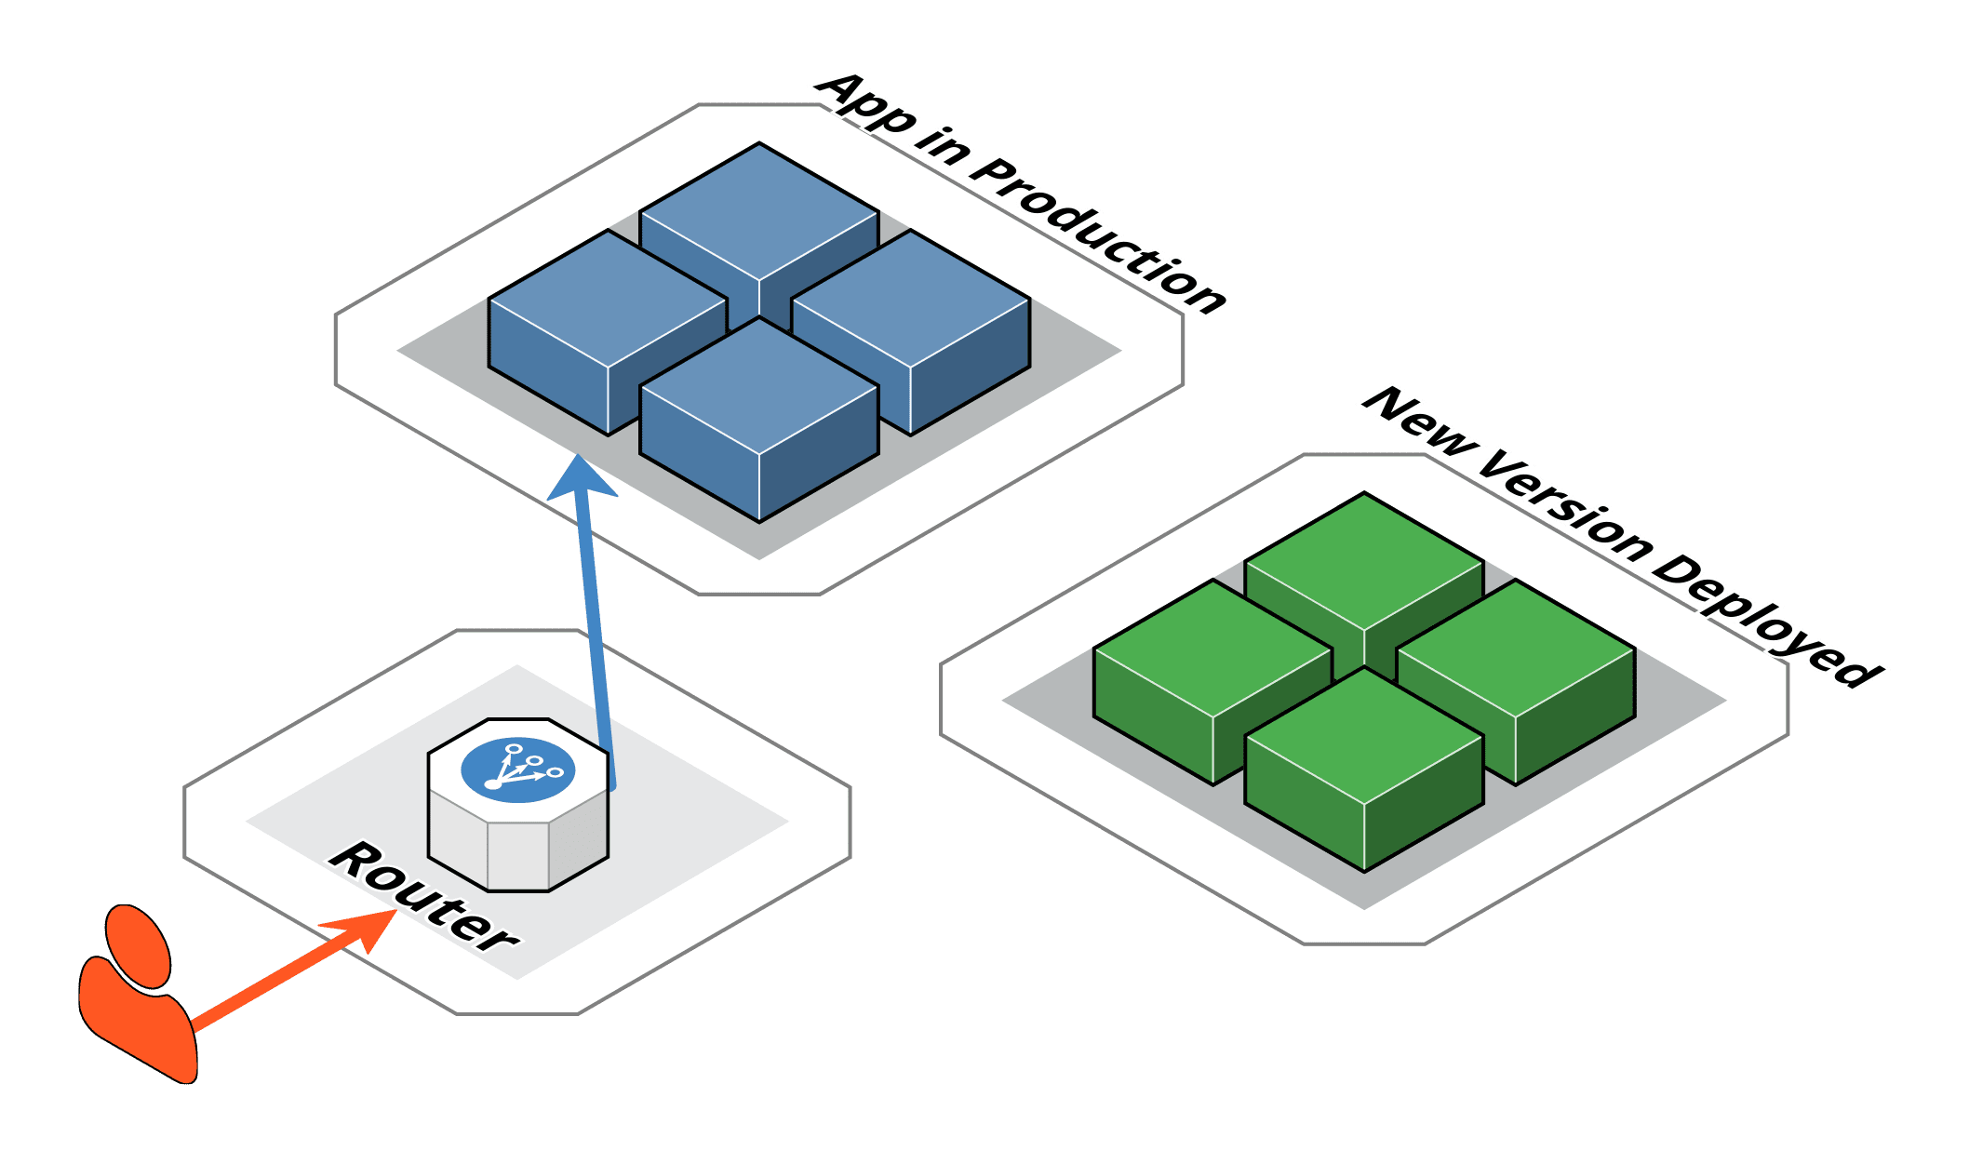
Blue Green Deployment
Traffic Switch Before and After
After 0% → Blue, 100% → Green
Before 100% → Blue, 0% → Green

Slide 11
03
Canary Deployment

Slide 12

Concept
Gradual Traffic Shift to New Version

Slide 13
Process
Step-by-Step Process
Deploy new version alongside current version
Route small percentage of traffic to new version
Monitor metrics and user feedback
Gradually increase traffic to new version
Complete rollout or rollback based on results

Slide 14
Traffic Distribution Example
Phased Traffic Distribution
Phase 0% old version, 100% new version
Phase 50% old version, 50% new version
Phase 80% old version, 20% new version
Phase 95% old version, 5% new version

Slide 15
Benefits
Reduced blast radius of issues
Key Benefits of Canary Deployment
Real user feedback on small subset
Gradual confidence building
A/B testing capabilities

Slide 16
Challenges
Key Challenges of Canary Deployment
Complex traffic management required
01.
02.
Monitoring overhead for multiple versions
Session affinity complications
Database schema compatibility
03.
04.

Slide 17
04
Deployment Strategy Comparison

Slide 18
Deployment Strategy Comparison
Strategy Comparison Metrics
Strategy | Downtime | Resource Usage | Rollback Speed | Risk Level | Complexity
Rolling Update | None | Normal | Medium | Medium | Low
Blue/Green | None | 2x Resources | Instant | Low | Medium
Canary | None | 1.1 – 1.5x Resources | Fast | Very Low | High
Recreate | High | Normal | Slow | High | Low

Slide 19
Use Case Recommendations
Blue/Green
Critical services, compliance requirements, simple stateless apps
Recommended Use Cases
Canary
User- facing applications, A/B testing, gradual feature rollouts
Rolling Update
Standard applications, resource- constrained environments
Recreate
Development environments, applications that can't run multiple versions

Slide 20
05
Rolling Update

Slide 21
Default Kubernetes Deployment Strategy
Key Configuration Parameters
MaxUnavailable
Maximum Pods that can be unavailable during update
MaxSurge
Maximum Pods that can be created above desired replica count

Slide 22
Key Configuration Parameters
Detailed Configuration
01
02
03
progressDeadlineSecondsMaximum
Time to wait for rollout
revisionHistoryLimit
Number of old ReplicaSets to keep
minReadySecondsMinimum
Time Pod should be ready before considering available

Slide 23

Step-by-Step Process
Detailed Steps
Create new ReplicaSet with updated Pod template
Scale down old ReplicaSet gradually (respecting maxUnavailable)
Scale up new ReplicaSet gradually (respecting maxSurge)
Repeat until all Pods are updated
Wait for new Pods to pass readiness checks
Clean up old ReplicaSets (keeping history for rollbacks)

Slide 24
06
Rollback Mechanisms

Slide 25
Manual Rollback Options
Different Rollback Options
Previous version rollbackQuick revert to last known good state
Specific revision rollbackTarget specific historical version
Status monitoringTrack rollback progress

Slide 26
Automatic Rollback Triggers
01
02
03
Progress deadline exceeded
Rollout taking too long
Health check failures
New Pods failing readiness/liveness probes
Custom metrics degradation
Business metrics showing issues
Examples of Automatic Triggers

Slide 27
Monitoring and Alerts
Best Practices for Monitoring
Set up alerts for failed deployments
Monitor key metrics during rollouts (error rates, response times)
Use health checks to validate Pod readiness
Implement circuit breakers for external dependencies

Slide 28
Rollback Triggers
High error rates (>1% increase)
Increased response times (>20% degradation)
Key Rollback Triggers
Failed health checks across multiple Pods
Resource exhaustion (CPU, memory spikes)
Business metric degradation (conversion rates, user satisfaction)

Slide 29
07
Autoscaling Overview

Slide 30
Importance of Autoscaling
Key Benefits
Cost Optimization
Scale down during low demand
Performance
Scale up during high demand
Reliability
Maintain service levels automatically
Efficiency
Right- size resources based on actual usage

Slide 31
Types of Autoscaling
Different Autoscaling Types
Type | What it Scales | Based on | Use Case
HPA | Number of Pods | CPU, Memory, Custom Metrics | Traffic variations
VPA | Pod resoure requests | Historical usage patterns | Resource optimization
Cluster Autoscaler | Number of Nodes | Pod scheduling pressure | Cluster capacity

Slide 32
08
Horizontal Pod Autoscaler (HPA)

Slide 33
HPA Components
Key Components
Metrics Server Collects resource usage data
HPA Controller Makes scaling decisions
Target Resource Deployment, ReplicaSet, or StatefulSet to scale

Slide 34
HPA Scaling Algorithm
Algorithm Explanation
desiredReplicas = ceil [currentReplicas * (currentMetricValue / desiredMetricValue)]

Slide 35
HPA Behavior Configuration
Configuration Options
Scale-up policies
Control how fast to add
Pods
Scale-down policies
Control how fast to remove Pods
Stabilization windows
Prevent thrashing

Slide 36
09
HPA Metrics Types

Slide 37
Resource Metrics
Common Resource Metrics
CPU utilization
Most common metric
Memory utilization
For memory- bound applications

Slide 38
Custom Metrics
Application-Specific Metrics
Application-specific metrics Requests per second, queue length
External metrics Cloud provider metrics, third- party services

Slide 39
Multiple Metrics Support
Scaling Based on Multiple Metrics
HPA can scale based on multiple metrics simultaneously
Uses the highest calculated replica count from all metrics

Slide 40
10
Vertical Pod Autoscaler (VPA)

Slide 41
What VPA Does
Key Functions
01
02
03
04
Analyzes historical resource usage
Recommends optimal CPU and memory requests
Can automatically update running Pods
Prevents resource waste and under- provisioning

Slide 42
VPA Modes
Off
Only provides recommendations
Initial
Sets requests when Pods are created
Auto
Updates requests for running Pods (requires Pod restart)
Different Modes

Slide 43
VPA Recommendation Types
Types of Recommendations
Target
Recommended resource requests
Lower Bound
Minimum recommended resources
Upper Bound
Maximum recommended resources
Uncapped Target
Recommendation without upper limit

Slide 44
11
HPA vs VPA Comparison

Slide 45
HPA vs VPA Comparison
Key Differences
Aspect | HPA | VPA
Scales | Pod replicas | Pod resources
Response Time | Fast (minutes) | Slow (Pod restart required)
Use Case | Traffic spikes | Resource optimization
Compatibility | Works with VPA | Can conflict with HPA
Stability | Production ready | Newer still maturing
Metrics | CPU, Memory, Custom | Historical usage patterns

Slide 46
Best Practice
Recommendation
Use HPA for scaling replicas and VPA for right- sizing individual Pods in different deployments.

Slide 47
Autoscaling Best Practices
Configuration Guidelines
Monitoring Requirements
- Set appropriate resource requests for accurate autoscaling
- Use multiple metrics (CPU, memory, custom) for better decisions
- Configure scaling behaviors to prevent thrashing
- Monitor costs associated with autoscaling
- Test autoscaling in non-production environments first
- Metrics collection: Ensure metrics server is running
- Alert setup: Configure alerts for scaling events
- Dashboard creation: Visualize scaling patterns
- Cost tracking: Monitor resource costs

Slide 48
Production Readiness Checklist
Deployment Strategy Checklist
Autoscaling Checklist
- ✅ Health checks configured (liveness, readiness)
- ✅ Resource limits and requests defined
- ✅ Monitoring and alerting in place
- ✅ Rollback procedures documented
- ✅ Deployment strategy selected and tested
- ✅ Metrics server installed and configured
- ✅ HPA/VPA policies defined and tested
- ✅ Resource requests properly set
- ✅ Scaling behaviors configured
- ✅ Cost monitoring in place

Slide 49
Summary and Key Takeaways
Deployment Strategies
- Choose strategy based on risk tolerance and resource availability
- Blue/Green for instant rollback capability
- Canary for gradual risk assessment
- Rolling updates for resource-efficient deployments
Autoscaling Strategy
- HPA for handling traffic variations
- VPA for resource optimization
- Combine both for comprehensive scaling
- Monitor and tune scaling policies regularly

Slide 50
Thanks
Karthikeyan Vaiyapuri

